Slide 1


Two-part Instruction Guide
for applying for and administering the NIP tax credit program

Slide 2
Table of Contents: This two-part Instruction Guide is designed to assist you and your organization with understanding and completing the NIP application as well as to instruct you on the administrative aspects of the program once credit is awarded.
Application Guide
Program Guide
Pg. 04 - What is the NIP
Pg. 05 – Eligibility Requirements
Pg. 06 – General Rules & Deadlines
Pg. 07 – Items You Will Need
Pg. 08 – Creating Your NIP Account
Pg. 09 – About the Application
Pg. 11 – Completing the Application
Pg. 12 – NIP Contacts
Pg. 14 – Important Dates
Pg. 15 – Program Rules
Limitations for NIP Tax Credits
Eligible Donations & Records
Ineligible Donations
Pg. 19 - Issuing Credits
Pg. 21 – Reporting Requirements
Pg. 27 – Reallocation
Pg. 28 – Signature Page

Slide 3
Part 1: Application Guide
for applying for the NIP tax credit program

Slide 4
What is the NIP?
The NIP was established by the West Virginia Legislature in 1996 to increase charitable giving to local nonprofit organizations, helping to increase the capacity of organizations to serve low-income West Virginia residents in highly distressed neighborhoods.
The program allows 501(c) 3 designated charitable organizations to apply for tax credit vouchers. These organizations utilize the tax credits to attract donations from businesses and individuals.
Businesses and individuals who contribute to NIP organizations are eligible to receive up to 50 percent of the contributed amount in the form of state tax credits. Donors may use the credits to reduce certain West Virginia tax liabilities.
In this way, businesses, individuals, nonprofits, and the State of West Virginia work together to alleviate poverty in the Mountain State.

Slide 5
Eligibility Requirements Applicant organizations must meet the following criteria:
Designated as a 501(c)3 organization by the IRS.
Currently registered and in good standing with the West Virginia Secretary of State's office as a charitable organization. Credit will not be awarded to organizations whose registration is not up-to-date at the time of the award announcement (typically, September 1st of each year).
Actively participate in fundraising activities and accept charitable donations. Organizations must also demonstrate a capacity to raise donations totaling 2 times the amount of tax credit requested on their application.
Serve low-income West Virginia residents in highly distressed communities.
Review this Instruction Guide and submit the Signature Page with your application. The Signature Page is on pg. 28 of this guide.

Slide 6
General Rules & Deadlines
Only one application will be accepted per FEIN.
Applications are available on our website at www.WVCAD.org/NIP by creating or signing into your organization’s NIP account.
Applications will only be accepted using the online format.
No incomplete applications will be considered.
No late applications will be considered.
Applications and all required documentation are due June 30th by 5 P.M.
Once submitted, you will immediately receive an email notification stating your application has been received. Only this E-MAIL will serve as proof that your application was submitted and received on time.
If additional documentation is requested, a 5-day grace period will be extended for the submission of the required forms.

Slide 7
Items You Will Need
Computer with internet access
Contact information for your organization’s CEO, Primary NIP Contact, and an Alternate NIP Contact (A minimum of two contacts is required)
Most recent year that your organization participated in the NIP
Most recent two-year history of your organization’s fundraising accomplishments
Required attachments (All attachments should be current or most recent copies)
IRS 501(c)(3) Determination Letter (www.IRS.gov)
Charitable Organization Confirmation from the Secretary of State’s office (304-558-8000) with an unexpired date
Annual Financial Statement
Board Resolution (Sample provided at www.wvcad.org/nip)
Include a list of Board Members along with the city, and state where they reside
NIP Program Contract (Provided at www.wvcad.org/nip)
NIP Instruction Guide Signature Page (Pg. 28 of the guide)

Slide 8
Creating Your NIP Account
Only new organizations will need to create an NIP account. Returning organizations will already have an account. If you need access to your organization’s account, email your request to: john.c.garner@wv.gov.
If your organization has never participated in the NIP:
Visit our website at: www.wvcad.org/nip
Select “NIP Login” on the upper right side of the screen
Select “Create New Account”
Follow the instructions and complete all required fields*
Once you have registered your account, you can select “Apply” from your organizations home page
If you have any questions, please email john.c.garner@wv.gov

Slide 9
About the Application
Applicants to the program are scored and ranked in a competitive application process using criteria as outlined in the NIP legislation. Therefore, projects should be:
Emergency Assistance and/or Direct Needs
Community based
Serving primarily low-income persons (incomes at or below 125% of the federal poverty level)
Serving highly distressed neighborhoods (economically distressed, crime and unemployment problems, high numbers of uneducated citizens, etc.)
Collaborating with other local organizations to maximize project benefits
Innovative or unique
Maintaining low administrative costs
Clearly needed in the project area
Able to demonstrate the capacity to deliver the proposed services
Effectively utilizing 100% of prior awarded credits

Slide 10
About the Application
When completing the application, take note of information that is in bold print, underlined, bullet pointed, or in red lettering. These are meant to emphasize certain requirements when responding to a particular question.
Remember to answer each question thoroughly and precisely. Brief answers that get straight to the point and cover all the required elements of the question are favored over long responses.
If your organization is awarded credit, your Project Description will be made public on our website. When completing this section, be sure to proofread and spell check as we will publish exactly what you submit.
In certain sections where data points are requested, such as “poverty rate” for example, you may use any current, trustworthy source of your choosing. However, be sure to list the source you are quoting in your response.
When you consider how much credit to request, remember, you will be required to demonstrate that your organization has successfully raised 2 times the amount of your request in donations for the past year.
The application deadline is June 30th at 5pm.

Slide 11
Completing the Application
To begin the application, login to your organization’s NIP account at www.wvcad.org/nip.
At the top left side, select “Apply”.
Complete all the required* responses making sure to answer each question thoroughly, providing sources where requested.
Attach all required documents.
Type your name in the signature line and add the date.
Click submit to send the application.
Check your email to ensure you have the “Application Received” email and then keep it somewhere safe as proof of your submission.
If questions arise, please contact me at john.c.garner@wv.gov.
Our office will be in contact should we need any additional information.
We anticipate awards being announced on September 1st.

Slide 12
NIP Contacts
Chris Garner, NIP Coordinator
John.C.Garner@wv.gov
Jennifer Ferrell, Director
Community Sustainability
Jennifer.L.Ferrell@wv.gov
Shelly J. Woda, Unit Manager
Shelly.J.Woda@wv.gov
West Virginia Development Office
Community Advancement and Development
Building 3, Suite 700
1900 Kanawha Boulevard, E.
Charleston, WV 25304
304-558-2234

Slide 13
Part 2: Program Guide
for administering the NIP tax credit program
13

Slide 14
Important Dates
September 1 | Award announcements are sent out via email. The email will also include two tax forms (WV/NIPA-1 and WV/NIPA-2).
September 1 | Begin using NIP tax credits to solicit donations.
December 31 | Last day to accept donations for the current tax year. (All donations made prior to the end of the tax year must be received and processed by January 31st.)
January 31 | Donations made before January 1 must be submitted to NIP staff for processing. (Prior year donations submitted after this date will be rejected.)
January 31 | Mid-term report due.
March 15 - 31 | Reallocation Period - All donations must be submitted to NIP staff for processing. No additional donations may be accepted for NIP credit until after this period.
April 1 | Reallocation Period is complete. You may again use NIP tax credits to solicit donations.
May 15 (estimate) | The next fiscal year grant application opens
June 30 | The next fiscal year grant application is due
June 30 | Last day to accept donations for the current grant period
July 31 | Last day to submit donation reports to NIP staff
July 31 | Final report due

Slide 15
Program Rules
When promoting NIP tax credits, it is important that you understand the rules so that you can explain them properly to your donors.
Limitations for NIP tax credits
The minimum donation for receiving credit is $500 (no cumulative donations allowed).
The maximum allowable credit given to a donor is $100,000
No donor may receive more than $100,000 in NIP credits for the tax year when combining all allowable donations that the donor has made to all NIP participating organizations.
An NIP certification fee of 3% of the donation is paid by the participating NIP organization to WVCAD via the ACH payment link on our website.
Credit given for an eligible donation cannot exceed 50% of the value of the donation.
Credits are used to offset Corporate Net Income Taxes and Personal Income Taxes.
Donors have the option of using the tax credit within one year or over a five-year period.
NIP credits cannot reduce total state tax liability by more than 50%.
All donations remain eligible for the Federal Charitable Contribution Deduction.
An NIP brochure is available to print on our website at: www.wvcad.org/nip.

Slide 16
Program Rules
Eligible Donations & Record Keeping
Cash - Allowable cash donations include:
Cash, Checks, Debit & Credit Cards, Cash Apps, and other 3rd party networks
Stock – Stock donations must be sold within 180 days of transfer
Record Keeping Requirements
Stock name, High/Low price on the day of transfer, and the Number of shares
The value of a stock donation is the average of the high and low price on the day of transfer times the number of shares.
Personal Property – All types of personal property (clothing, cars, etc.)
Record Keeping Requirements
List of all Item(s) donated
The value is the agreed upon fair market value.
Motor Vehicles require the following additional records: VIN #, make, model, year, and the fair market value.

Slide 17
Program Rules
Eligible Donations & Record Keeping
Real Property – Keep a copy of the deed in your files
Record Keeping Requirements
Address, Type of Property (residential, commercial), Tax Assessed Value
The value of real property is the tax assessed value divided by 60%
In-kind Services – Credit is only available to certain state licensed professionals
Record Keeping Requirements
Type of Service, Service Provider, State License Number, Value of the Service Provided
In-kind services must be accompanied by a cash donation equal to 75% of the total donation
For additional information regarding in-kind services, email john.c.garner@wv.gov

Slide 18
Program Rules
Ineligible Donations
Donations less than $500 in value
Cumulative Donations
Payroll Deductions
In-kind Services other than those performed by specified state licensed professionals
Donations which equal less than $500 after consideration of any goods or services given to the donor, such as sponsorships, golf tournament registrations, etc. These should be valued the same way they are for the IRS federal deduction.
Leased Property
Donations made prior to the NIP certification date

Slide 19
Issuing Credit
You will receive two forms attached to your award notification email. You will provide these forms to each person or business that makes an eligible contribution to your organization’s NIP project.
WV/NIPA-1 – This is the credit voucher you will complete and give to the donor.
Section I will be prefilled with your project information details.
Section II must be completed by the issuing organization.
Donor Information Section: Include the donor(s) legal name, address, contribution amount, circle the type of donation, amount of credit given, and the date of the donation.
Sponsor Information Section: Provide the signature of your organization’s authorized NIP representative, printed name, telephone number, and date.
WV/NIPA-2 – This is a WV tax form which you should also give to the donor.
WV/NIPA-2 – Link to the WV tax form.
This form is to be completed by the donor or their tax representative.
Be sure to properly document each donation for future reference

Slide 20
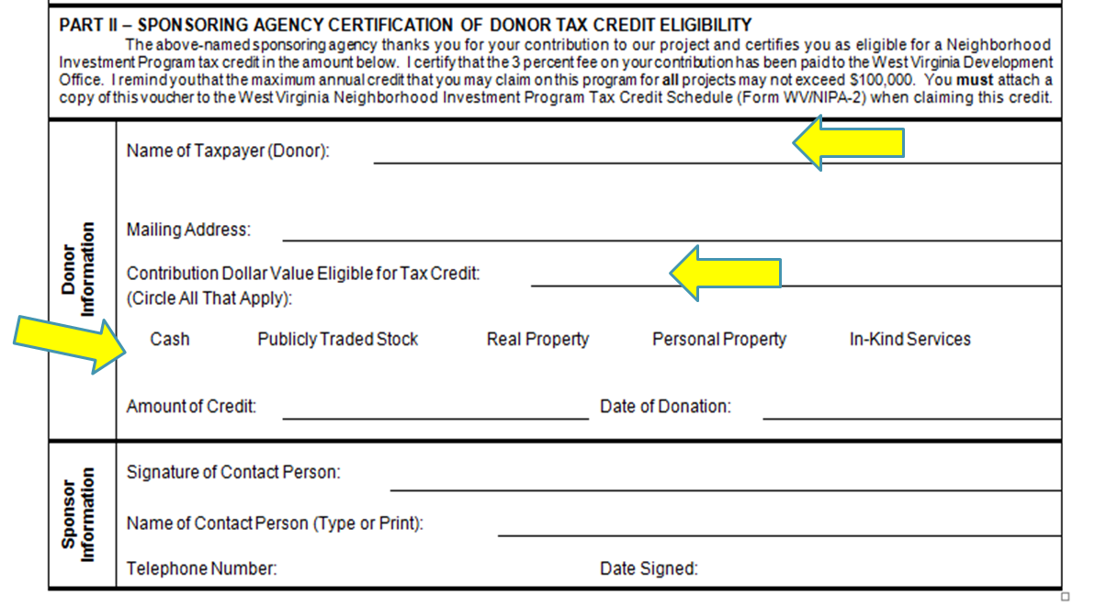
Issuing Credit Sample of Part II – WV/NIPA-1 form
Legal Name(s) of donor(s)

Slide 21
Reporting Requirements
There are three reports that are required by the NIP. They can be located on your organization’s NIP home page after you have been awarded credit.
Donations Report – Used to report donations made in exchange for NIP credit.
It is designed to collect necessary donation data for reporting requirements to the West Virginia tax department.
You will learn more about this report on the next few pages.
Mid-term Report – This report serves as your organization’s progress report.
It collects useful information related to your NIP project.
It covers the period between Sep. 1st and Dec. 31st and is due on Jan. 31st.
Final Report – The Final Report is cumulative.
The final report will be loaded to your home page after you have submitted the mid-term report.
It collects data about your project that helps support the need for the NIP.
It covers the period between Sep. 1st and Jun. 30th and is due on Jul. 31st.
We encourage the sharing of related photos and stories to help promote your work.

Slide 22
Reporting Requirements
Reporting donations and credit issued is a three-step process.
Record the donation information (Donation Processing Form – excel file)
Make the ACH certification fee payment (Portal on NIP website)
Report the donations (Donations Report located on your NIP home page)
Step 1. Record the Donation Information
All donations must be recorded using the Donation Processing form found on our website at: www.wvcad.org/nip. This is the only form we will accept.
Do not use previously saved forms as edits to the form are occasionally necessary and may render older editions unusable.
Follow all instructions as outlined on the form. Additional instructions will pop up as you tab through the form.
Save the form in its original excel format using the following example:
Organization Name – NIP Donations – Transaction #
Later, you will rename the file replacing “Transaction #” with the actual transaction number that is provided to you when you make the ACH payment for NIP certification fees. This fee is automatically calculated on the Donation Processing form.

Slide 23
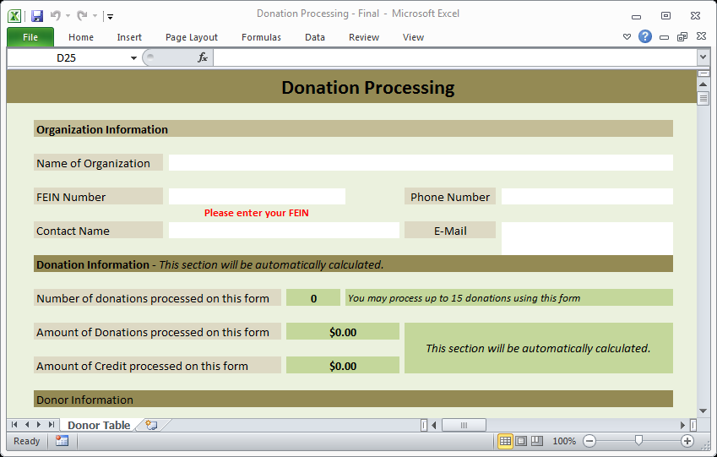
Reporting Requirements
Sample of the Donation Processing form
FEIN must include the dash
55-1234567

Slide 24
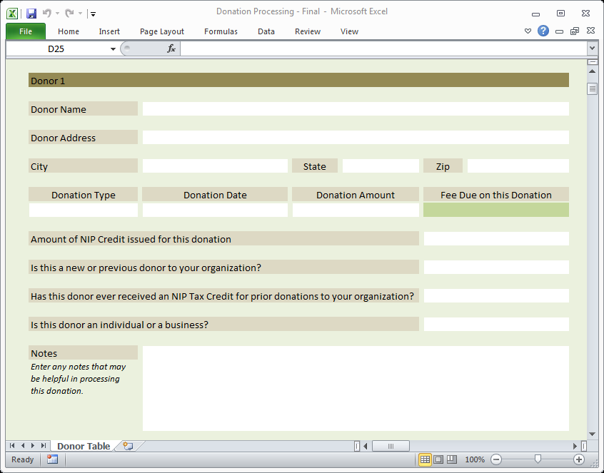
Reporting Requirements
Sample of the Donation Processing form
MM/DD/YYYY
Use the correct date format and make sure the date is between Sept 1st and June 30th.

Slide 25
Reporting Requirements
Step 2. Make the ACH Certification Fee Payment
After you have recorded and saved the donation information on the Donation Processing form and before you submit your report, you must make an ACH payment using the portal available at our website at www.wvcad.org/nip.
Visit our website at www.wvcad.org/nip.
Select ACH Payment Link located on the right side of the page.
Follow all instructions as you complete and submit the payment.
The fee amount owed is automatically calculated and can be found on the Donation Processing form at both the top and bottom of the form.
Make sure to update the required information at the bottom of the Donation Processing form including the transaction number, amount of the payment, and the date the payment was made. (The transaction # will be given to you when you submit the ACH payment.)
Save the Donation Processing form and remember to replace “Transaction #” at the end of the file name with the actual transaction number.

Slide 26
Reporting Requirements
Step 3. Report the Donations
After you have made the ACH payment, you are now ready to report the donations to the NIP.
Visit our website at www.wvcad.org/nip.
Select the NIP Login link located on the right side of the page and login.
On your organization’s home page, you will be able to see all reports assigned to your user ID. If you do not see a report, email john.c.garner@wv.gov to correct the issue.
Open the Donations Report by selecting <Start>.
Complete the form being careful to follow all the instructions.
Upload your Donation Processing form in its original excel format.
A maximum of 5 forms may be uploaded to your report
Type your name and date. Then, submit the report. We will contact you if there are any issues.
If you discover that you need to correct donor information that has previously been reported, reach out to me by email with the corrections. Do not submit corrections through the reporting portal.

Slide 27
Reallocation
Reallocation is a two-week period in March, when everything pauses and credit awards are reevaluated based on your organization’s credit issuance rate.
Reallocation begins on Mar. 16th and ends on March 31st.
During this time, you are not permitted to accept donations for NIP credit.
All donations must be collected and reported by Mar. 15th to be counted toward your organization’s credit issuance rate.
The goal for your organization’s credit issuance rate is to have issued at least 70% of your credit award.
Organizations that have not issued 70% of their credit will forfeit all remaining credit.
Organizations that have issued 70% but less than 100% will retain their remaining credit.
Organizations that have issued 100% of their credit award and that were highly ranked during this initial application review period may be eligible for additional credit.
You will be notified in advance if your organization will be offered credit.
Reallocation ends on Mar. 31st and donation processing begins again on Apr. 1st.

Slide 28
Signature Page
This Instruction Guide was created to help assist your organization in understanding the purpose of the Neighborhood Investment Program, how to apply for the NIP grant, and how to administer the grant if credit is awarded.
By signing below, you and your organization attest that you have read the Instruction Guide and understand the requirements of the program.
Required Signatures
CEO: ______________________________________________ Date: _________
Primary NIP Contact: ________________________________ Date: __________
Alternate NIP Contact: _______________________________ Date: _________

Slide 29
NIP Contacts
Chris Garner, NIP Coordinator
John.C.Garner@wv.gov
Jennifer Ferrell, Director
Community Sustainability
Jennifer.L.Ferrell@wv.gov
Shelly J. Woda, Unit Manager
Shelly.J.Woda@wv.gov
West Virginia Development Office
Community Advancement and Development
Building 3, Suite 700
1900 Kanawha Boulevard, E.
Charleston, WV 25304
304-558-2234

